Slide 1



CAPSTONE PROJECT
CSA1308-THEORY OF COMPUTATION
LangCheck: Regular Language Verification System
Faculty:
Dr.G.Kumaresan
By:
192311039 PETA.HARSHA VARDHAN

Slide 2

Introduction
Overview of the Project
This project implements a Regular Language Verification System to analyze and verify regular languages using formal automata concepts. It allows users to create, validate, and test regular expressions and finite automata, perform conversions between NFA and DFA, and verify whether input strings are accepted or rejected. The system provides an interactive interface, stores verification data, and generates reports and analytics for analysis and testing.
Problem Statement
Regular language verification can involve complex automata operations.
Manual conversion between NFA, ε-NFA, and DFA can cause errors.
Users may find automata transitions difficult to visualize.
An efficient system is needed for automated verification and analysis.
Purpose of the Project
The purpose of the project is to provide a systematic platform for verifying regular languages by analyzing regular expressions, finite automata, and input strings. It aims to automate automata conversions, validate language acceptance, maintain user and verification data, and provide reports and analytics.

Slide 3
Objectives
Define Clear Goals
Verify whether given languages satisfy regular language properties.
Process regular expressions and construct equivalent finite automata
Convert ε-NFA and NFA representations into DFA for verification.
Test input strings and generate accurate acceptance or rejection results.
Address the Problem Statement
Regular language verification often involves complex operations such as automata construction, ε-closure computation, NFA-to-DFA conversion, and string validation. Performing these operations manually can be time-consuming and may result in errors. This project addresses these issues by providing a structured system to automate regular language verification, visualize automata, manage verification data, and simplify the analysis of formal language concepts.
Expected Outcomes
• Successful verification of regular languages and finite automata.
• Accurate conversion between ε-NFA, NFA, and DFA representations.
• Correct identification of accepted and rejected input strings.
• Detailed verification reports with testing and analytical results.
• Improved understanding of regular languages and automata theory.

Slide 4
Literature Review / Background
S. No | Author(s), Year & Journal | Title | Methodology | Limitations
1 | Rabin, M.O. & Scott, D. (1959), IBM Journal of Research and Development | Finite Automata and Their Decision Problems | Studied finite automata as language-recognition mechanisms and established algorithms for several automata decision problems. | Primarily theoretical and does not provide an interactive verification system. (DOI)
2 | Brzozowski, J.A. (1964), Journal of the ACM | Derivatives of Regular Expressions | Introduced derivatives of regular expressions and used them as an algebraic basis for analyzing regular languages and constructing deterministic automata. | The derivative approach can produce many distinct expressions/states for complex regular expressions. (SIGMOD)
3 | Thompson, K. (1968), Communications of the ACM | Programming Techniques: Regular Expression Search Algorithm | Presented an algorithm for regular-expression searching based on finite-state representations, providing an important practical approach to regex processing. | Focuses primarily on regular-expression searching rather than a complete regular-language verification workflow. (Danish Websites)
4 | Hopcroft, J.E. (1971), Theory of Machines and Computations | An n log n Algorithm for Minimizing States in a Finite Automaton | Proposed an efficient state-minimization algorithm with worst-case complexity bounded by n log n, also applicable to determining equivalence of finite automata. | Specifically focuses on finite-automaton minimization and equivalence rather than the complete language-verification process. (ScienceDirect)
5 | Antimirov, V.M. (1996), Theoretical Computer Science | Partial Derivatives of Regular Expressions and Finite Automaton Constructions | Introduced partial derivatives of regular expressions and applied them to construct relatively small NFAs, with improvements to automata construction from regular expressions. | Primarily addresses derivative-based automata construction and does not cover a complete user-oriented verification and reporting system. (ScienceDirect)

Slide 5
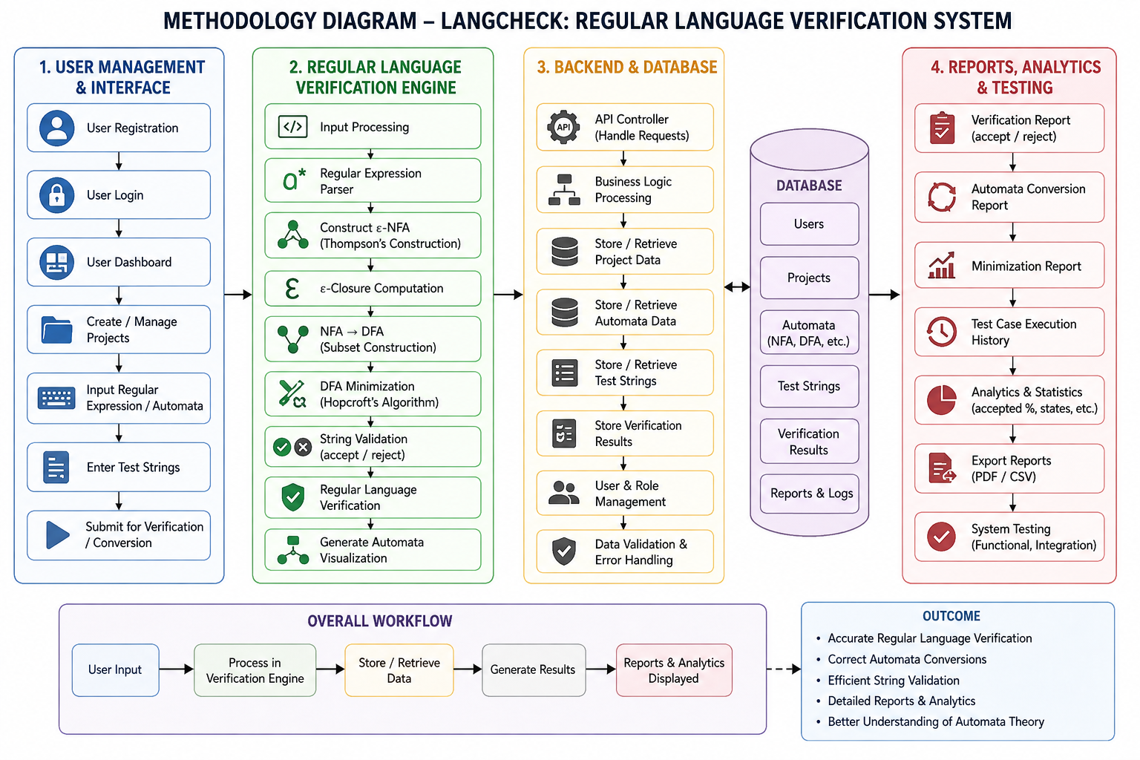
Methodology
Tools & frameworks used
Tool/Framework | Purpose
Nmap | Network and service scanning
Enum4linux | SMB and share enumeration
RPCDump | RPC endpoint enumeration
Metasploit | Vulnerability validation and exploitation
Windows OS | Target environment for testing
Data Collection
Windows system information
RPC endpoints and services
SMB shares and permissions
Null session accessibility
Vulnerability and CVE details
Development Approach
The project follows a penetration testing and vulnerability assessment approach. Information is gathered from Windows systems, SMB shares and RPC services are enumerated, vulnerabilities are identified, and privilege escalation paths are analyzed in a controlled lab environment. The findings are then documented with security recommendations.

Slide 6
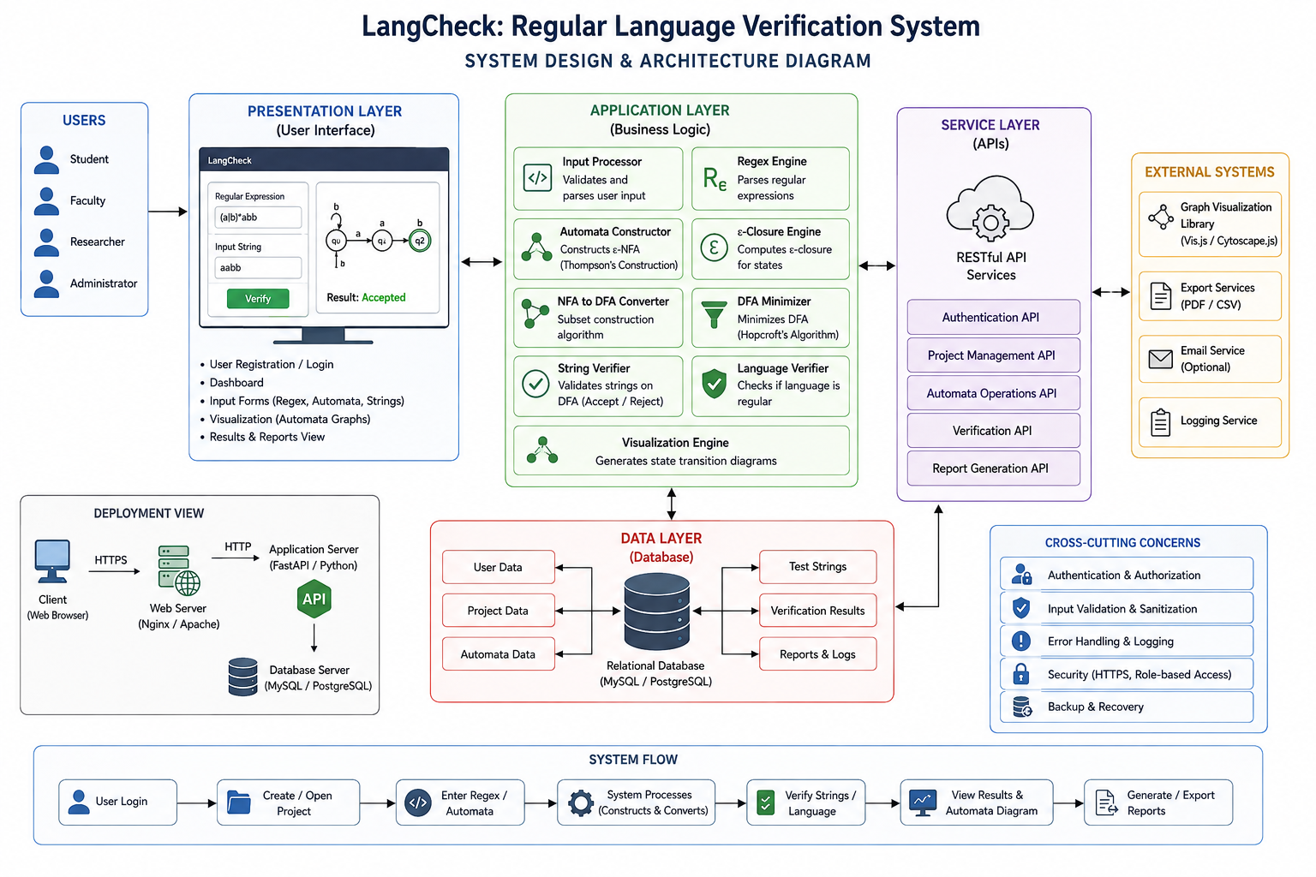
System Design / Architecture

Slide 7
User Management & Interface
Purpose
The purpose of this module is to provide a secure and user-friendly interface for accessing and using the LangCheck system.
How to Implement
Implement user registration and login.
Provide a user dashboard.
Allow users to create, open, and manage projects.
Provide input forms for regular expressions, automata, and test strings.
Implement input validation.
Provide interactive automata visualization.
Display verification results clearly.
Findings
Users can access the system through authenticated accounts.
Projects and verification activities can be organized efficiently.
Interactive visualization makes automata easier to understand.
Input validation reduces incorrect or incomplete submissions.
Output
Registration and Login Interface
User Dashboard
Project Management Interface
Regular Expression / Automata Input
Test String Input
Automata Visualization
Verification Result Display

Slide 8
Regular Language Verification Engine
Purpose
The purpose of this module is to automatically construct, convert, analyze, and verify finite automata and regular languages.
How to Implement
Parse the entered regular expression.
Construct an ε-NFA using Thompson's Construction.
Calculate ε-closure for the required states.
Convert NFA to DFA using Subset Construction.
Minimize the DFA using Hopcroft's Algorithm.
Validate input strings using the generated DFA.
Determine whether each string is accepted or rejected.
Generate automata visualizations and transition tables.
Findings
Regular expressions can be converted into equivalent automata.
ε-NFA can be systematically converted into DFA.
DFA minimization reduces unnecessary or equivalent states.
Input strings can be automatically classified as accepted or rejected.
The verification process reduces errors associated with manual calculations.
Output
Regular Expression Analysis
ε-NFA
NFA
DFA
Minimized DFA
ε-Closure Results
Transition Tables
Accepted / Rejected Strings
Regular Language Verification Result
Automata Visualization

Slide 9
Backend & Database
Purpose
The purpose of this module is to provide the backend processing, API communication, and persistent storage required by LangCheck.
How to Implement
Develop REST APIs for communication between frontend and backend.
Implement business logic for verification operations.
Create database tables for users and projects.
Store automata, test strings, and verification results.
Implement CRUD operations.
Implement authentication and authorization.
Add input validation and error handling.
Maintain verification history and project data.
Findings
Centralized backend processing improves system organization.
Database storage allows users to save and retrieve previous projects.
API-based communication separates the frontend from backend processing.
Verification results and test cases can be maintained for future analysis.
Output
REST APIs
User Database
Project Database
Automata Records
Test String Records
Verification Results
Reports and Logs
Verification History

Slide 10
Reports, Analytics & Testing
Purpose
The purpose of this module is to evaluate system performance, analyze verification results, and generate detailed reports.
How to Implement
Execute predefined and user-defined test cases.
Maintain teast execution history.
Calculate acceptance and rejection statistics.
Analyze the number of automata states and transitions.
Generate verification and automata conversion reports.
Perform functional testing.
Perform integration testing.
Export reports in PDF/CSV formats.
Findings
Testing helps identify errors in the verification engine.
Analytics provide a clear overview of verification activities.
Test history allows previous results to be reviewed.
Reports make verification results easier to document and analyze.
Output
Verification Reports
Automata Conversion Reports
DFA Minimization Reports
Test Execution History
Acceptance / Rejection Statistics
Performance Analysis
PDF / CSV Reports
Functional and Integration Test Results

Slide 11
Implementation
Module | Functions & Functionalities
MOD 1 – User Management & Interface | User registration/login, dashboard, project management, regular-expression and test-string input, and interactive automata visualization.
MOD 2 – Regular Language Verification Engine | Regular-expression processing, ε-NFA construction, ε-closure calculation, NFA-to-DFA conversion, DFA minimization, and string acceptance/rejection verification.
MOD 3 – Backend & Database | API communication, authentication, project management, database storage, automata and test-result management, data validation, and error handling.
MOD 4 – Reports, Analytics & Testing | Verification reports, conversion results, test-case execution, verification history, analytics, performance testing, functional/integration testing, and report export.

Slide 12
Results & Discussion
Outcomes of the Project
Successfully verifies regular languages using finite automata and regular expressions.
Performs ε-NFA, NFA-to-DFA conversion, and DFA minimization.
Tests input strings and accurately identifies accepted or rejected strings.
Provides interactive automata visualization and verification results.
Generates verification reports, analytics, and testing results.
Feature | Existing Tools | Proposed Framework
Regular Expression Processing | ✓ | ✓
Automata Construction | ✓ | ✓
ε-Closure Calculation | Limited | ✓
NFA to DFA Conversion | ✓ | ✓
DFA Minimization | Limited | ✓
String Verification | ✓ | ✓
Automata Visualization | Limited | ✓

Slide 13
Challenges & Limitations
Issues Faced During Development
Handling different regular-expression formats and validating user inputs.
Implementing correct ε-closure and automata conversion operations.
Managing complex state transitions during NFA-to-DFA conversion.
Ensuring accurate DFA minimization and string verification results.
Integrating the verification engine, backend, database, and user interface.
Testing the system with different regular expressions, automata, and input strings.
Possible Constraints
Complex regular expressions may increase processing time.
Invalid or unsupported input formats may affect verification.
Large automata may require more memory and processing resources.
Visualization can become difficult with a large number of states and transitions.
Database or backend failures may affect result storage and retrieval.
Current prototype may have limited support for advanced language-analysis features.

Slide 14
Future Scope
Enhancements or Improvements
Add support for advanced regular-expression analysis and validation.
Improve automata visualization for complex state transitions.
Add step-by-step visualization of ε-closure and NFA-to-DFA conversion.
Enhance analytics with detailed acceptance/rejection statistics.
Improve report generation with graphical automata and verification summaries.
How This Project Can Be Extended Further
Support additional automata operations such as DFA equivalence and language comparison.
Add advanced regular-expression optimization and analysis features.
Introduce collaborative project sharing and online verification.
Develop real-time interactive automata editing and simulation.
Extend the system to support educational exercises, quizzes, and automated evaluation.

Slide 15
Conclusion
Summary of the Project
This project developed LangCheck: Regular Language Verification System, which provides automated regular-language analysis through regular-expression processing, finite automata construction, conversion, string verification, and DFA minimization. The system combines user management, verification processing, backend and database services, and reporting features to provide an efficient platform for analyzing and understanding regular languages.
Key Takeaways
Gained practical experience in Regular Languages and Automata Theory.
Learned regular-expression processing and finite automata construction techniques.
Implemented ε-closure, NFA-to-DFA conversion, and DFA minimization.
Developed string verification, automata visualization, and reporting features.
Understood the importance of automated testing, verification accuracy, and systematic language analysis.

Slide 16
References
Rabin, M. O., & Scott, D. (1959). Finite Automata and Their Decision Problems. IBM Journal of Research and Development, 3(2), 114–125.
Brzozowski, J. A. (1964). Derivatives of Regular Expressions. Journal of the ACM, 11(4), 481–494.
Thompson, K. (1968). Programming Techniques: Regular Expression Search Algorithm. Communications of the ACM, 11(6), 419–422.
Hopcroft, J. E. (1971). An n log n Algorithm for Minimizing States in a Finite Automaton. In Theory of Machines and Computations, 189–196.
Antimirov, V. M. (1996). Partial Derivatives of Regular Expressions and Finite Automaton Constructions. Theoretical Computer Science, 155(2), 291–319.

Slide 17
Thank You!
Any Questions?

